Slide 1
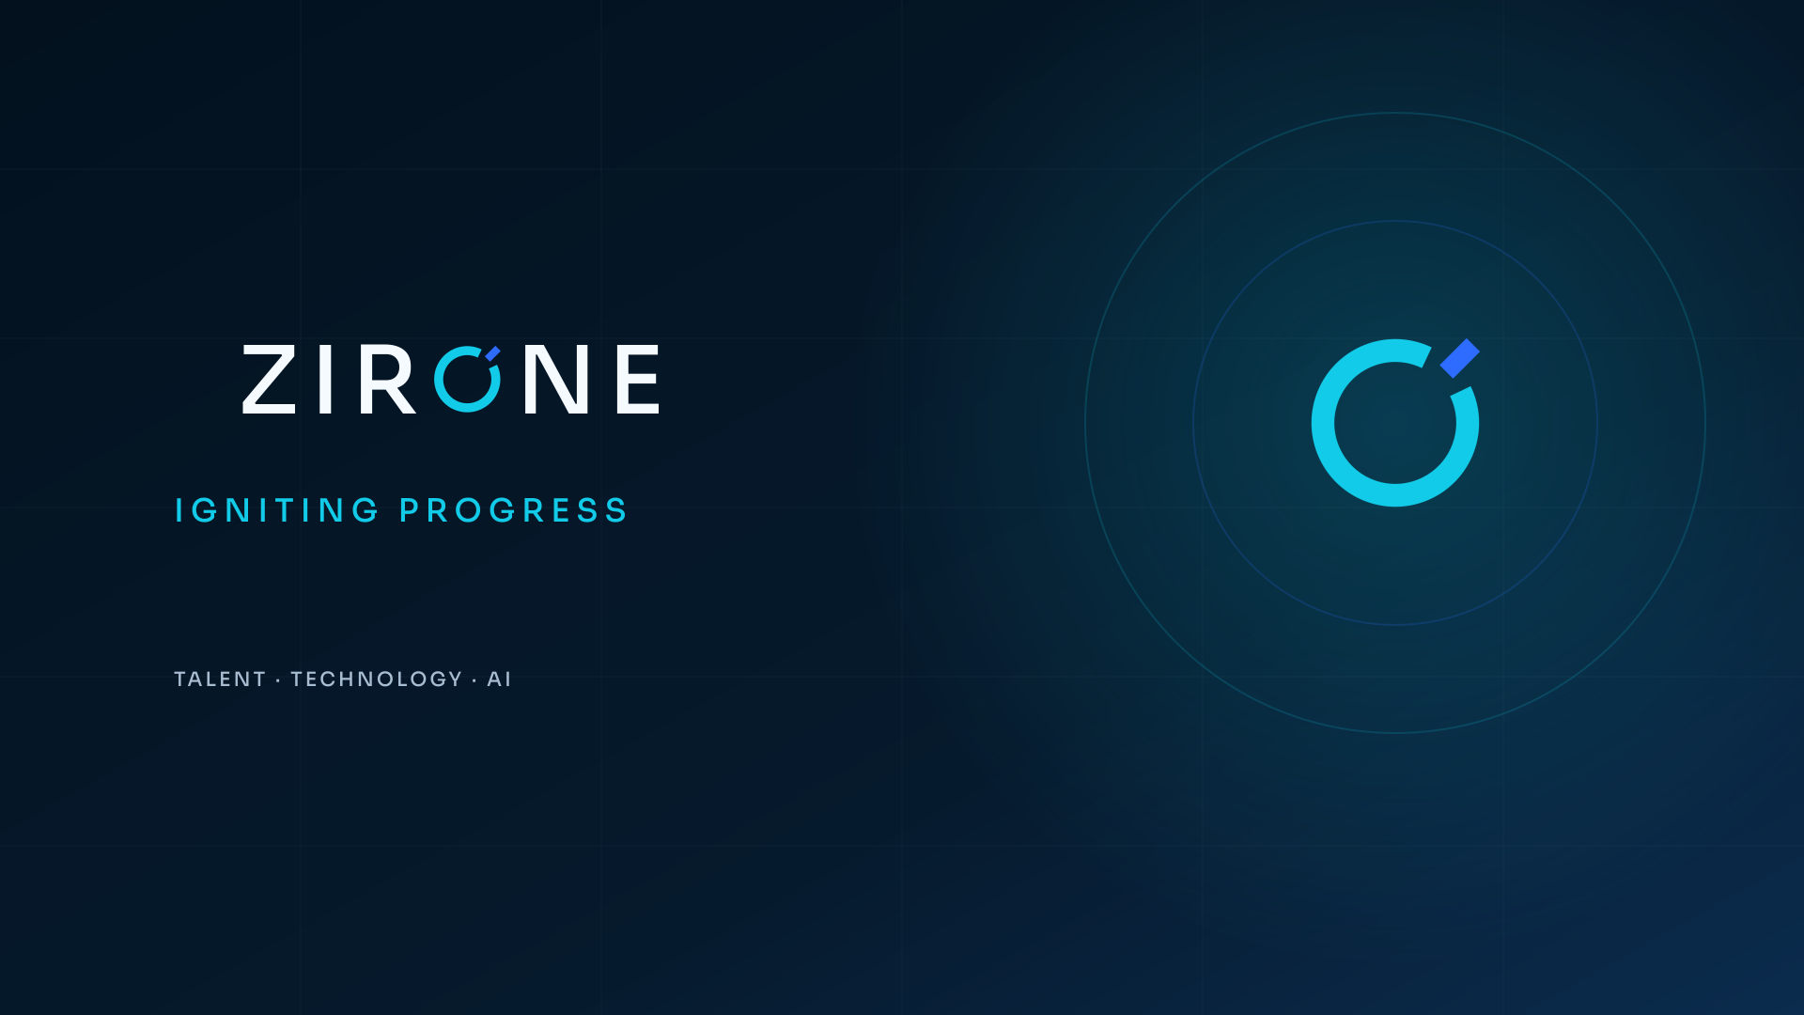
Talent · Technology · AI
Enterprise capability overview
One accountable partner for the people and systems behind progress.
Notes:
[Sources]
- Zirone approved 2026 identity package and user-provided business positioning (2026-08-07).
- No external statistics, client claims, or third-party assets used.

Slide 2

ONE ZIRONE
Talent and technology are usually the same business problem.
Zirone connects the people, platforms, intelligence, and learning needed to move an enterprise priority forward.
01
02
03
Zirone Talent
Technology & AI
Zirone Forge
Specialized people for critical roles and shifting workloads.
Enterprise change grounded in the workflow and operating reality.
Applied learning that moves from concept to build to deployment.
ZIRONE · IGNITING PROGRESS
02
Notes:
[Sources]
- Zirone approved 2026 identity package and user-provided business positioning (2026-08-07).
- No external statistics, client claims, or third-party assets used.

Slide 3

THE ZIRONE DIFFERENCE
Start with the real requirement—not the service catalog.
The outcome, environment, evidence, disqualifiers, deadline, and decision process determine the right person and the right delivery model.
Clear requirement → better search → safer delivery
The requirement is the first deliverable.
ZIRONE · IGNITING PROGRESS
03
Notes:
[Sources]
- Zirone approved 2026 identity package and user-provided business positioning (2026-08-07).
- No external statistics, client claims, or third-party assets used.

Slide 4
ZIRONE TALENT
People who fit the work—not only the keywords.
Contract · Contract-to-hire · Direct hire · Project teams
Technology & AI
→
Enterprise applications & ERP
→
Engineering & technical
→
Healthcare
→
Build the team.
Legal & professional services
→
Leadership & delivery
→
Fit the person to the work—not only the keywords.
ZIRONE · IGNITING PROGRESS
04
Notes:
[Sources]
- Zirone approved 2026 identity package and user-provided business positioning (2026-08-07).
- No external statistics, client claims, or third-party assets used.

Slide 5

ENTERPRISE TECHNOLOGY
Reduce friction. Strengthen the foundation.
Focused consulting and embedded expertise across the systems organizations rely on every day.
01
Enterprise applications & ERP
02
Data, integration & analytics
Modernize the enterprise.
03
Cloud, security & modern engineering
ZIRONE · IGNITING PROGRESS
05
Notes:
[Sources]
- Zirone approved 2026 identity package and user-provided business positioning (2026-08-07).
- No external statistics, client claims, or third-party assets used.

Slide 6
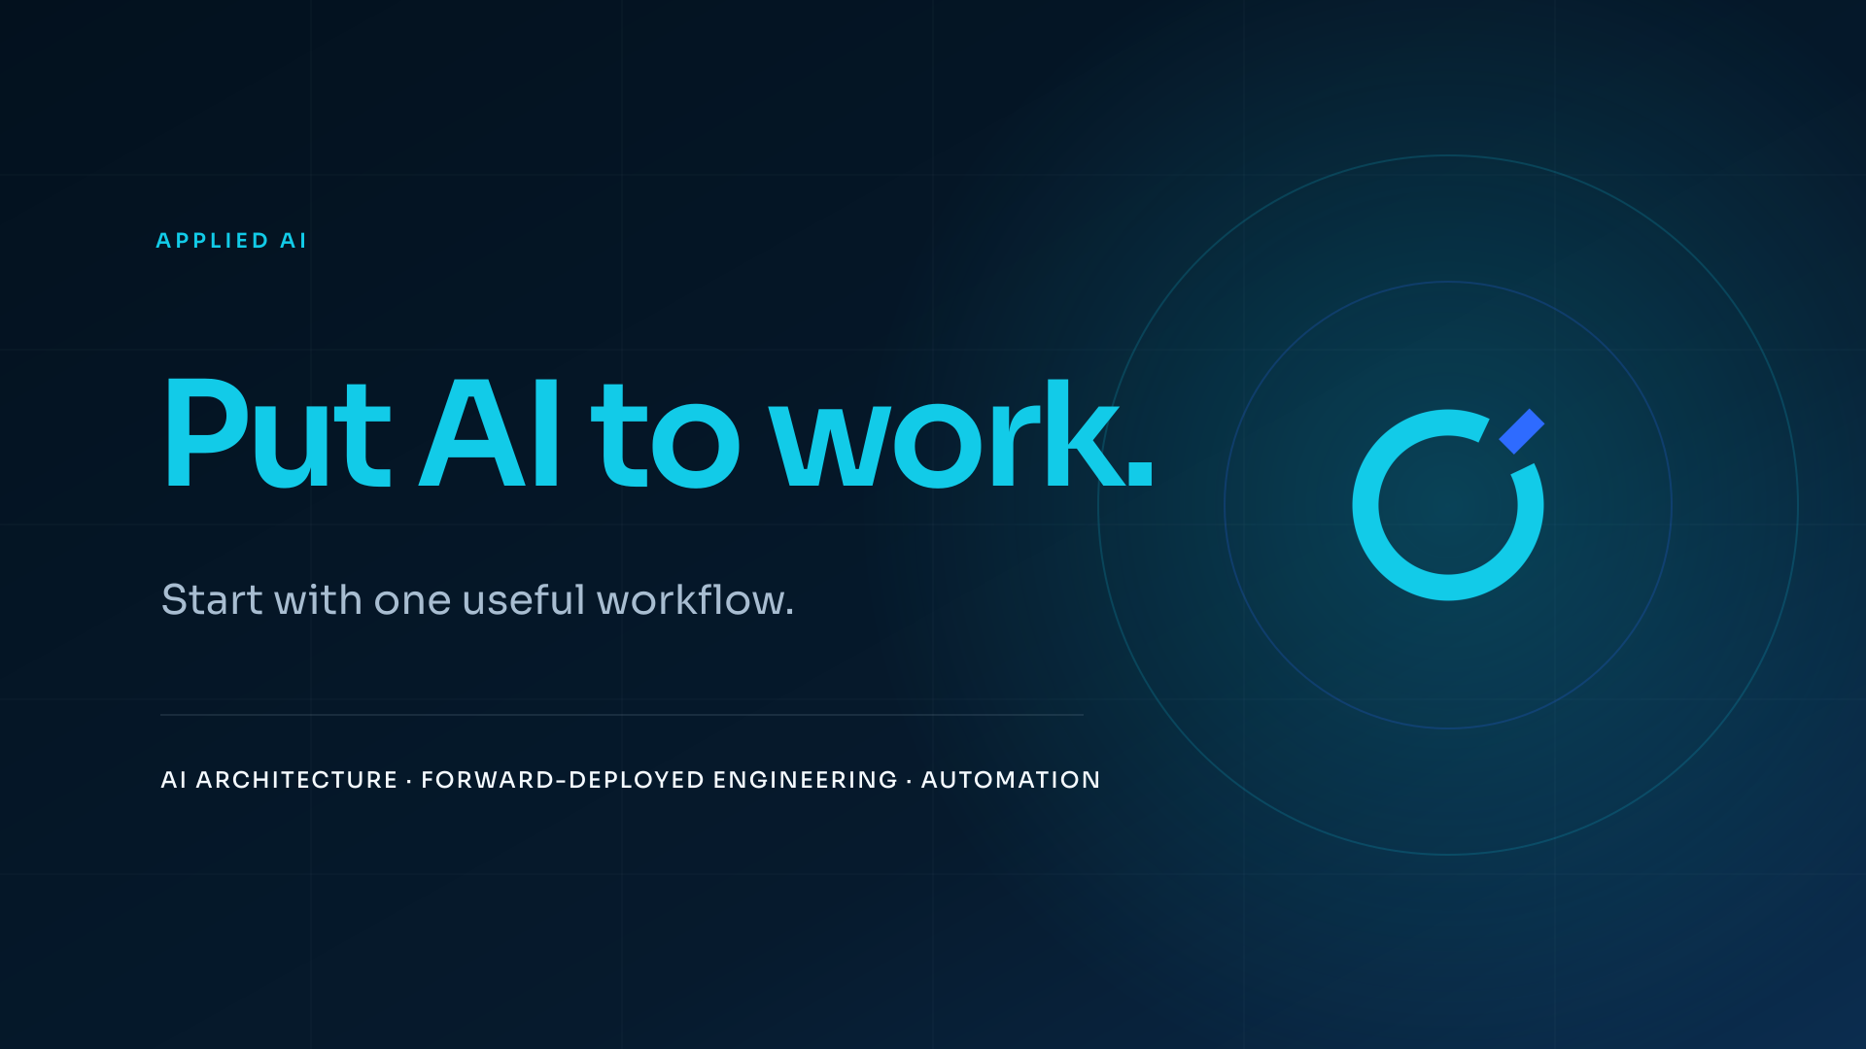
A useful first workflow is more valuable than a theatrical AI roadmap.
Opportunity & readiness · Enterprise AI architecture · Forward-deployed engineering · Evaluation & guardrails
ZIRONE · IGNITING PROGRESS
06
Notes:
[Sources]
- Zirone approved 2026 identity package and user-provided business positioning (2026-08-07).
- No external statistics, client claims, or third-party assets used.

Slide 7
CORE EXPERTISE
Broad enough for the enterprise. Focused enough to deliver.
01
Enterprise Applications & ERP
Platforms, higher education, integration, upgrades, testing, change, and support.
02
AI & Intelligent Automation
Readiness, architecture, copilots, evaluation, workflow automation, and engineering.
03
Data, Integration & Analytics
Strategy, pipelines, APIs, data quality, governance, analytics, and reporting.
04
Cloud, Security & Engineering
Cloud, cybersecurity, application modernization, DevOps, quality, and support.
ZIRONE · IGNITING PROGRESS
07
Notes:
[Sources]
- Zirone approved 2026 identity package and user-provided business positioning (2026-08-07).
- No external statistics, client claims, or third-party assets used.

Slide 8
INDUSTRY CONTEXT
How IT and non-IT fit under one roof.
Industries define the operating context. Talent and Technology define how Zirone helps.
01
Higher Education
04
Legal & Professional Services
Talent + enterprise systems + AI
Professional talent + secure digital workflows
02
Healthcare & Life Sciences
05
Financial & Business Services
Talent + enterprise systems + AI
Professional talent + secure digital workflows
03
Manufacturing & Engineering
06
Public & Mission-Driven
Talent + enterprise systems + AI
Professional talent + secure digital workflows
ZIRONE · IGNITING PROGRESS
08
Notes:
[Sources]
- Zirone approved 2026 identity package and user-provided business positioning (2026-08-07).
- No external statistics, client claims, or third-party assets used.

Slide 9
SIGNATURE DEPTH
18+
Higher education belongs inside Enterprise Applications & ERP—not as a disconnected navigation tab.
That depth improves requirement quality, search calibration, integration thinking, stakeholder awareness, and delivery context across the portfolio.
years inside enterprise applications and higher education
A real specialization should sharpen the entire business—not trap it in a silo.
ZIRONE · IGNITING PROGRESS
09
Notes:
[Sources]
- Zirone approved 2026 identity package and user-provided business positioning (2026-08-07).
- No external statistics, client claims, or third-party assets used.
- Experience duration is user-provided and should be verified in final client-facing use.

Slide 10
THE ZIRONE WAY
Clarity before velocity.
Scope increases only when evidence justifies the next move.
01
02
03
04
Align
Qualify
Deliver
Improve
Define the outcome, context, constraints, and real deadline.
Test fit with evidence, structured questions, and clear gaps.
Put the right people and plan around the defined work.
Close the loop, transfer knowledge, and strengthen the next move.
ZIRONE · IGNITING PROGRESS
10
Notes:
[Sources]
- Zirone approved 2026 identity package and user-provided business positioning (2026-08-07).
- No external statistics, client claims, or third-party assets used.

Slide 11
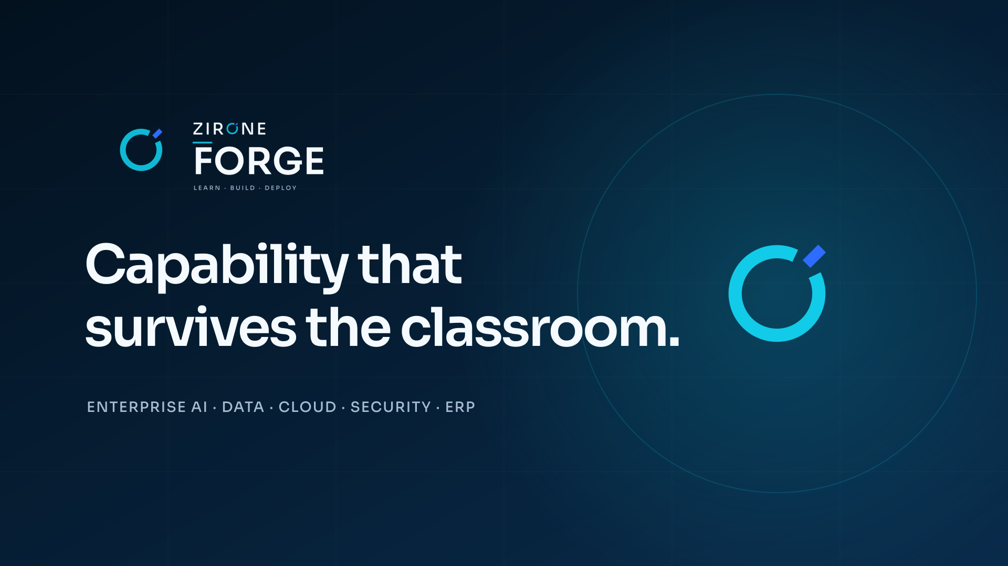
Private team workshops · Curated cohorts · Applied build labs
ZIRONE · IGNITING PROGRESS
11
Notes:
[Sources]
- Zirone approved 2026 identity package and user-provided business positioning (2026-08-07).
- No external statistics, client claims, or third-party assets used.

Slide 12
A PRACTICAL FIRST STEP
Start with one bounded question.
01
Role & requirement calibration
A success profile, screening rubric, search map, and engagement recommendation.
02
AI opportunity sprint
A prioritized workflow, readiness view, risk frame, and proof-of-value plan.
03
ERP & integration health check
A focused view of friction, dependencies, support risk, and practical next moves.
Bring the role, roadmap, or hard problem.
zirone.com · info@mail.zirone.com · +1 (872) 888-3926
ZIRONE · IGNITING PROGRESS
12
Notes:
[Sources]
- Zirone approved 2026 identity package and user-provided business positioning (2026-08-07).
- No external statistics, client claims, or third-party assets used.

